Slide 1

BASIC BANK​ MANAGEMENT​ SYSTEM

Slide 2
Group Members:
NAMES | REGISTRATION NUMBERS
D.S.S MADHAVI | AP23110011420
K. AKHILA | AP23110011422
K. PUJITHA | AP23110011433
B. SAI PRIAYANKA | AP23110011450

Slide 3
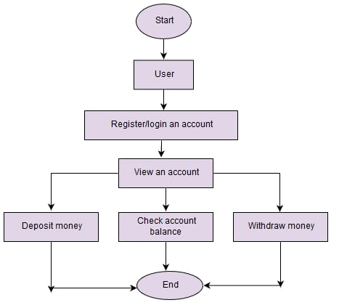
INTRODUCTION
A bank management system is a software application designed to manage banking operations efficiently.
It helps in handling various banking activities like account management, transactions, and customer data.
This project aims to create a reliable and user-friendly banking application using C++.

Slide 4
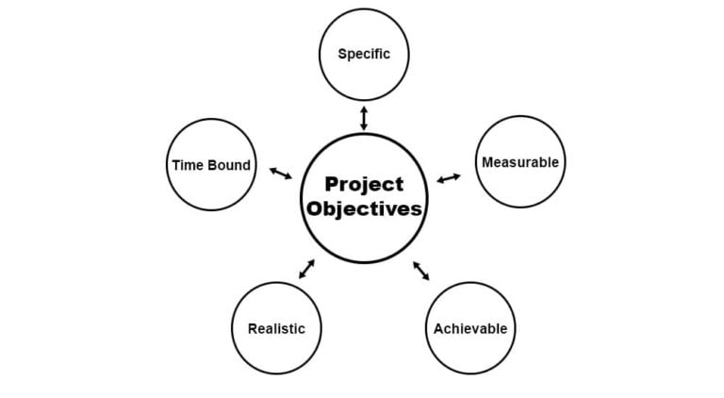
OBJECTIVES
Minimizing Human Errors
To reduce manual intervention, thereby minimizing errors in calculations, record-keeping, and transaction processing
Streamlining Banking Operations:
Automate routine tasks like account management, transactions, and reporting to improve efficiency and reduce manual workload.
Ensuring Security and Data Integrity:
Protect sensitive customer information with robust security measures and ensure accurate, error-free data handling.

Slide 5
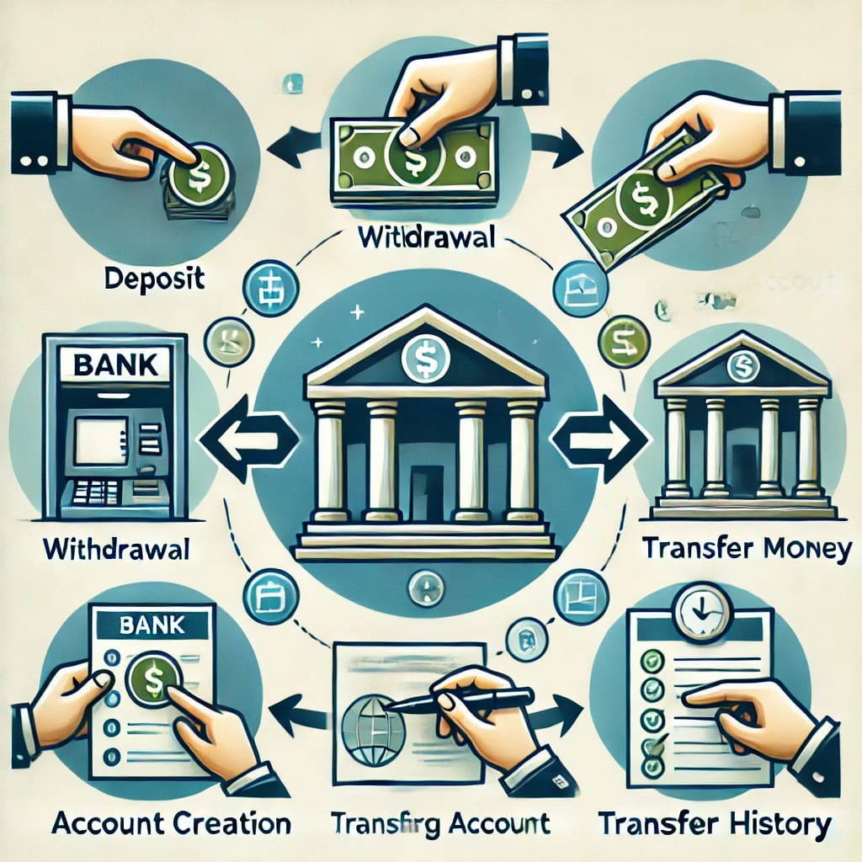
KEY FEATURES
Account Management
Creation and Deletion: Create and delete accounts.
Modification: Update account details.
2. Transaction Handling
Deposit and Withdrawal: Manage deposits and withdrawals.
Balance Inquiry: Check account balances.
3. Transaction History
Logging Transactions: Record all transactions.
Viewing History: View transaction history.
4. Customer Management
Information Storage: Store and update customer details.
5. File Handling
Persistent Storage: Save and retrieve account data and transaction
history.

Slide 6
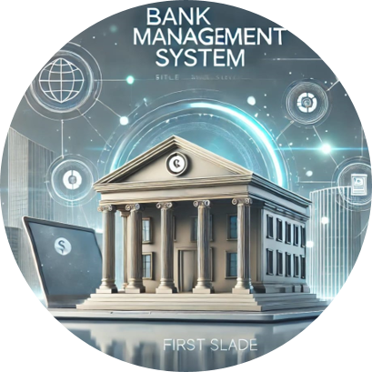
TECHNICAL FRAMEWORK
Object-Oriented Programming (OOP).​
Dynamic Memory Management.​
Encapsulation with Private/Public Access Modifiers.​
Constructor, Destructor, Copy Constructor, and Assignment Operator.
Modular Design and Code Reusability.​

Slide 7
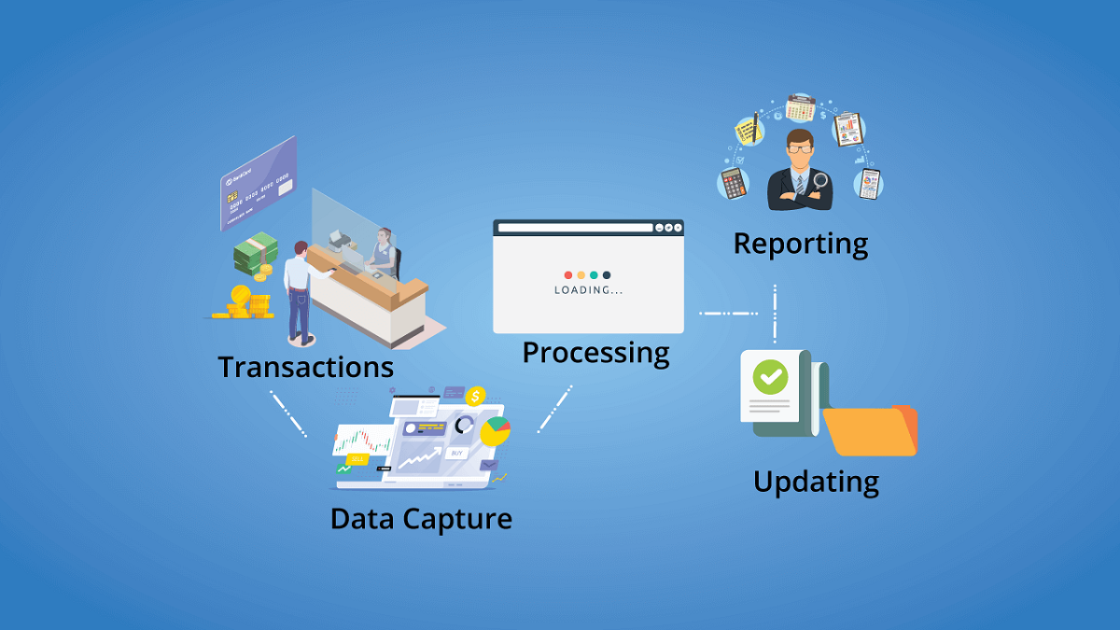
Account Management Module
This module allows for the creation and management of user accounts.
Users can view account details, such as balance and transaction history.
The module also handles account closure requests and ensures data integrity.
Transaction Management Module
This module facilitates various transactions like deposits, withdrawals, and transfers.
Each transaction is logged for transparency and auditing purposes.
The system ensures that all transactions adhere to banking regulations.

Slide 8
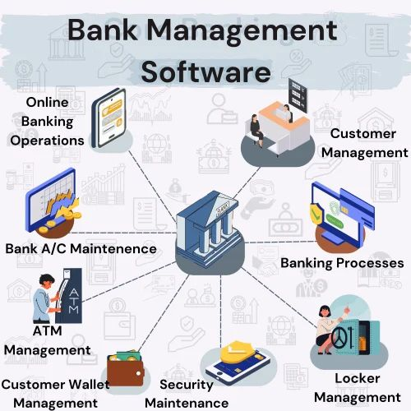
FUTURE ENHANCEMENT
User-Friendly Interface
Make the system easy to use with clear menus and options for users to check their balance, transfer money, and view transactions.
Secure Login System
Add secure login features like a username and password, and send notifications for account activities to ensure safety
Transaction History
Allow users to view their past transactions with details like date, amount, and type of transaction (deposit or withdrawal).
1
2
3

Slide 9

CONCLUSION
The Bank Management System project successfully meets its objectives of automation and user satisfaction.
It demonstrates the effectiveness of C++ in developing complex applications.
It saves time, reduces errors, ensures data safety, and provides a user-friendly experience.
Future work will focus on expanding features and improving security measures.

Slide 10
REFERENCES
C++ Programming Language, Bjarne Stroustrup, Addison-Wesley.
Computer Networking: A Top-Down Approach, James Kurose and Keith Ross.
Online resources and documentation related to C++ and banking systems.

